Slide 1
Online Banking System
By: RamaKoti Reddy Peram
Batch:2022-8271

Slide 2
Banking Application
Online banking allows a user to conduct financial transactions via the Internet.
Online banking is also known as Internet banking or web banking.
Online banking offers customers almost every service traditionally available through a local branch including deposits, transfers, and online bill payments.

Slide 3
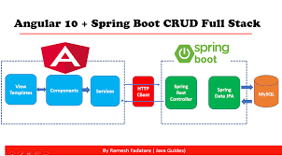
Requirments

Slide 4
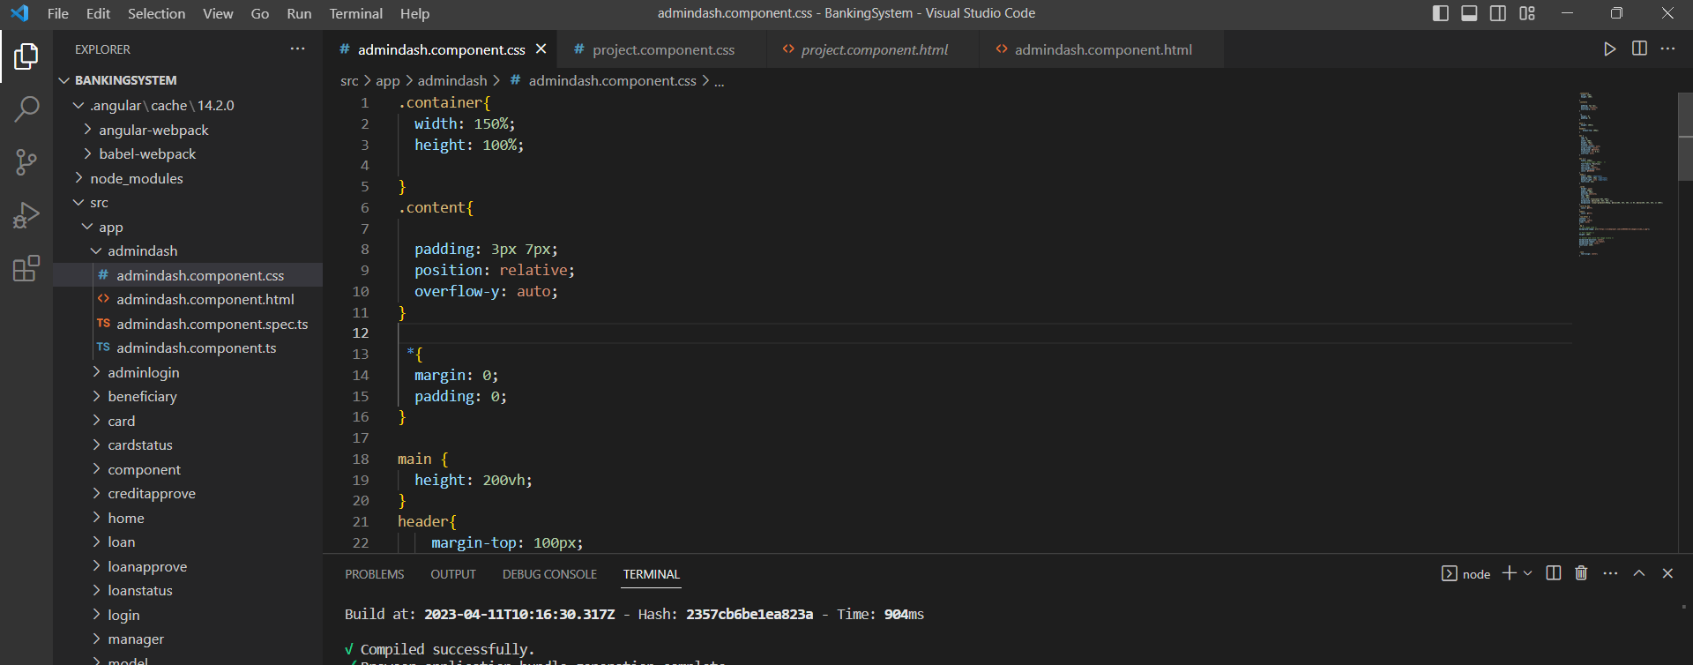
Angular 8

Slide 5
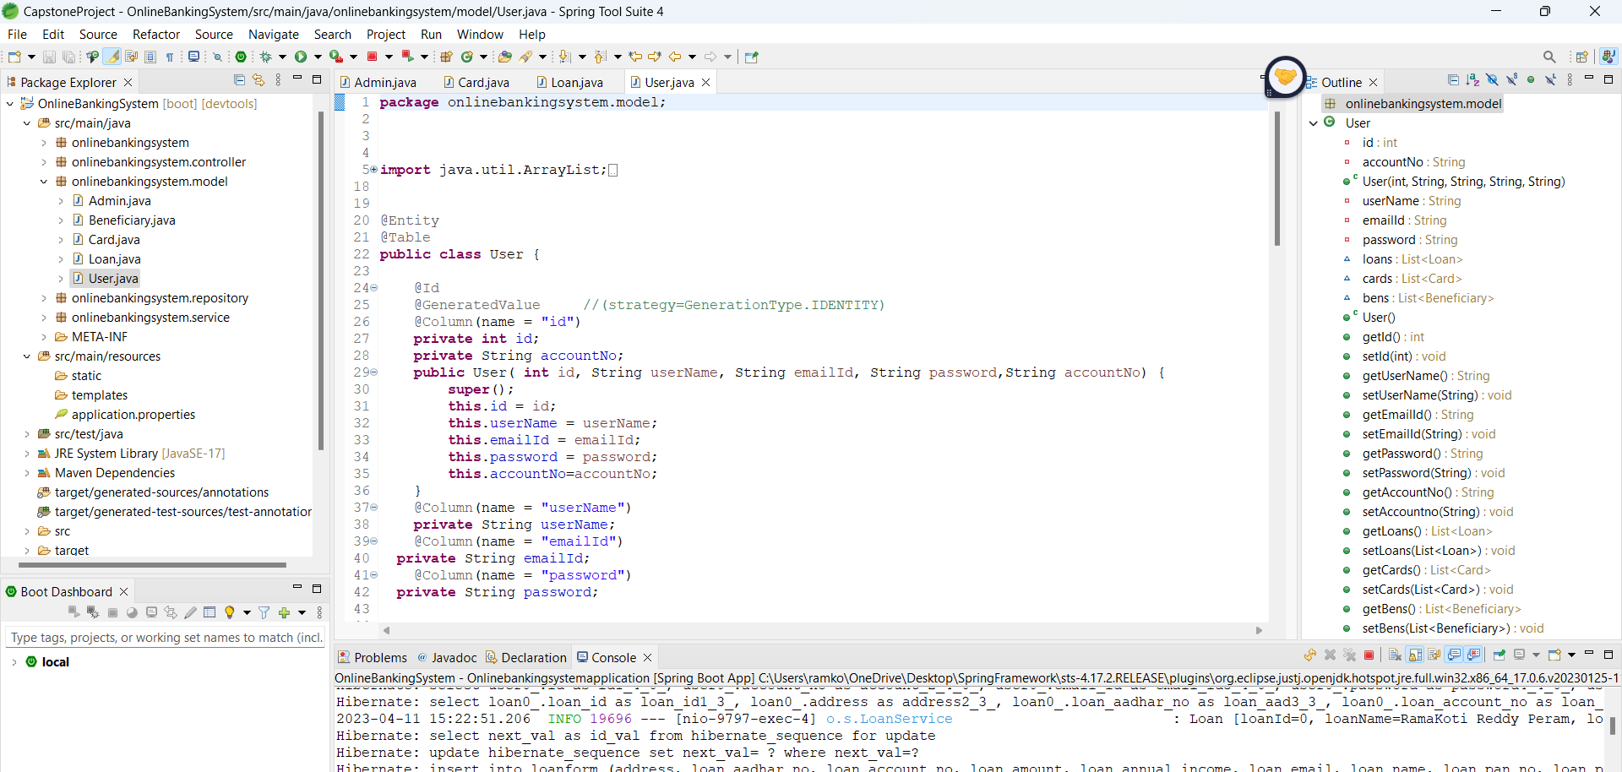
Entity

Slide 6
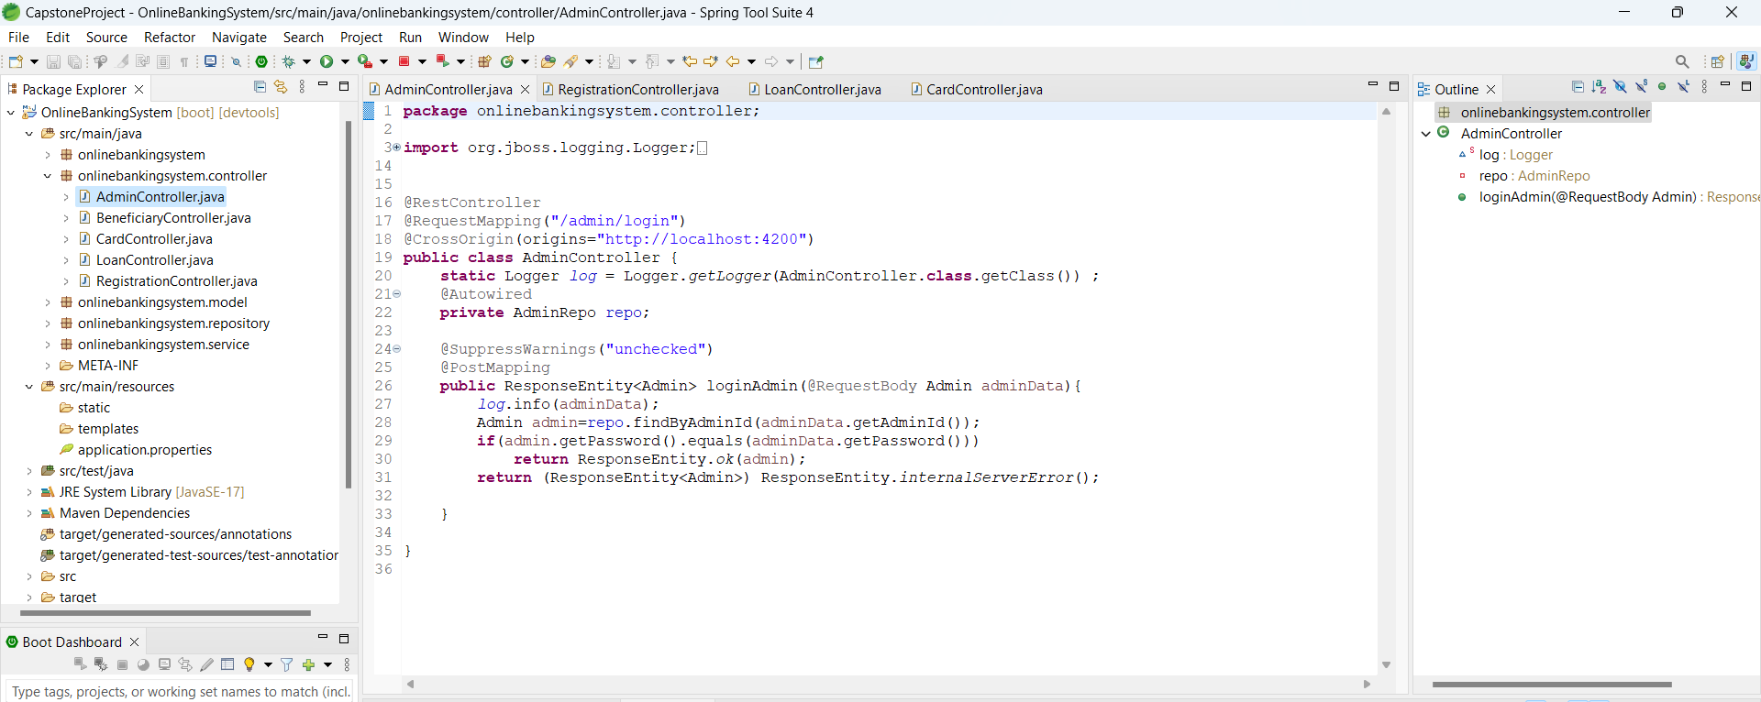
Controller

Slide 7
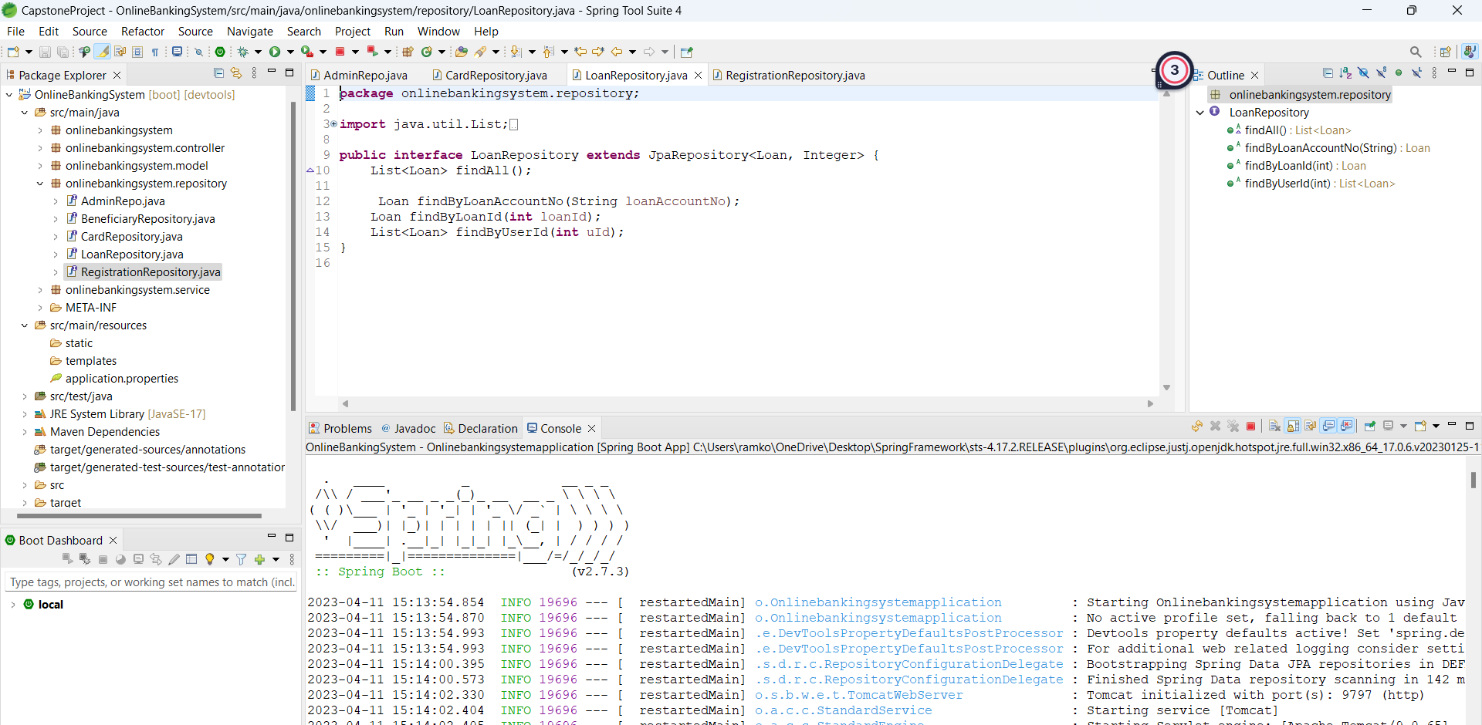
Repository's

Slide 8
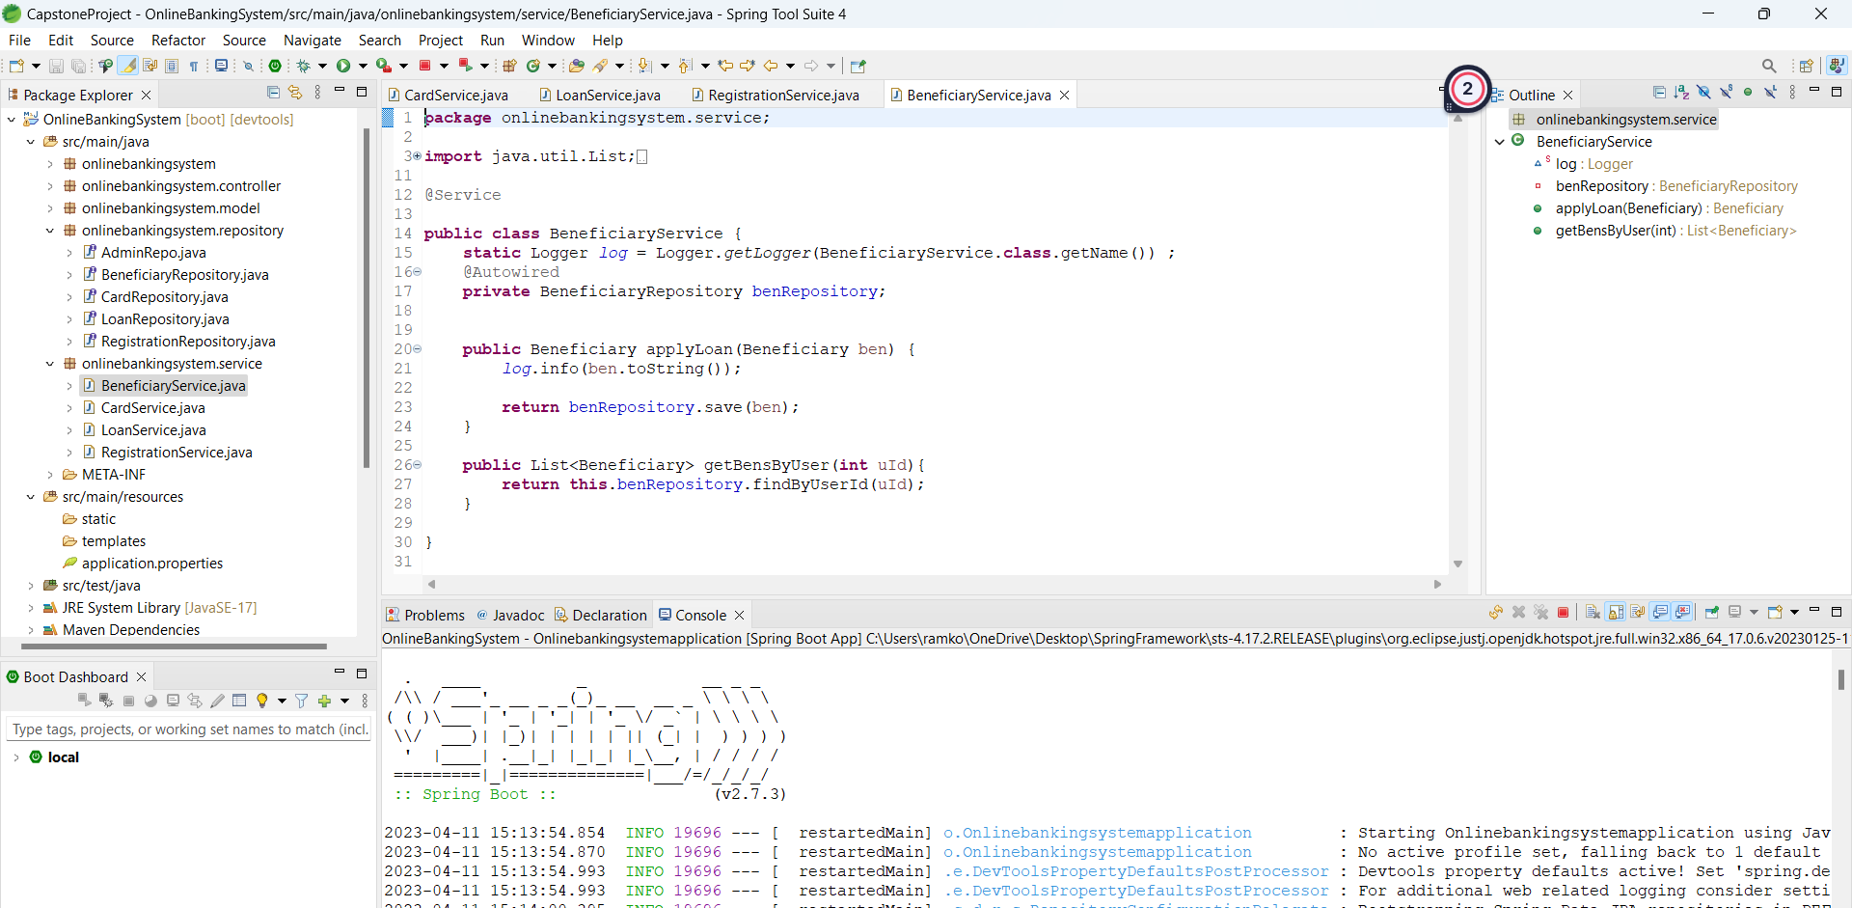
Services

Slide 9
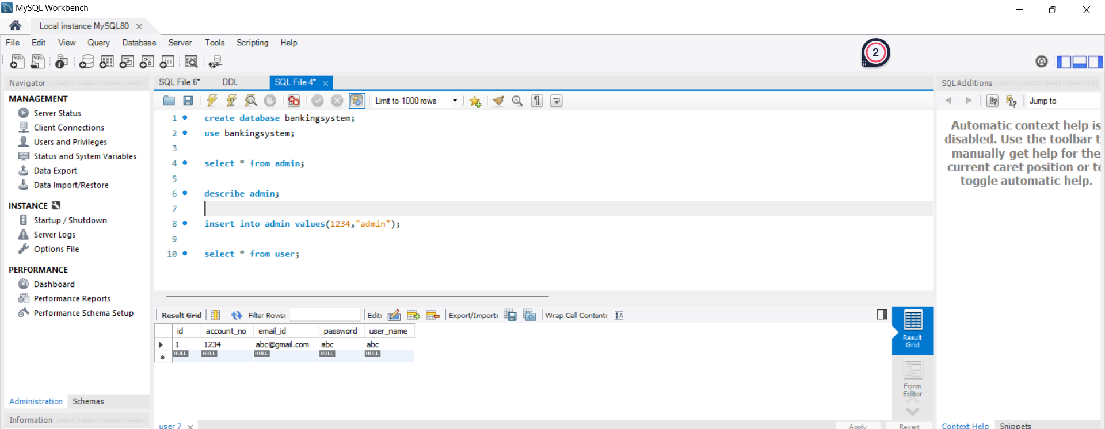
MySql

Slide 10
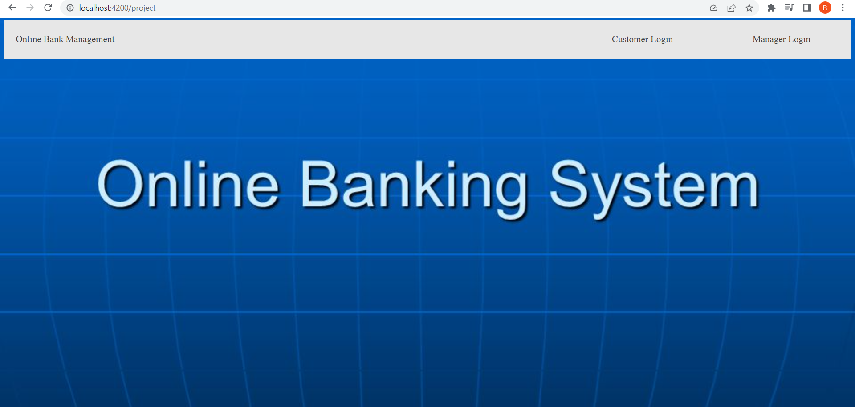
Home Page

Slide 11
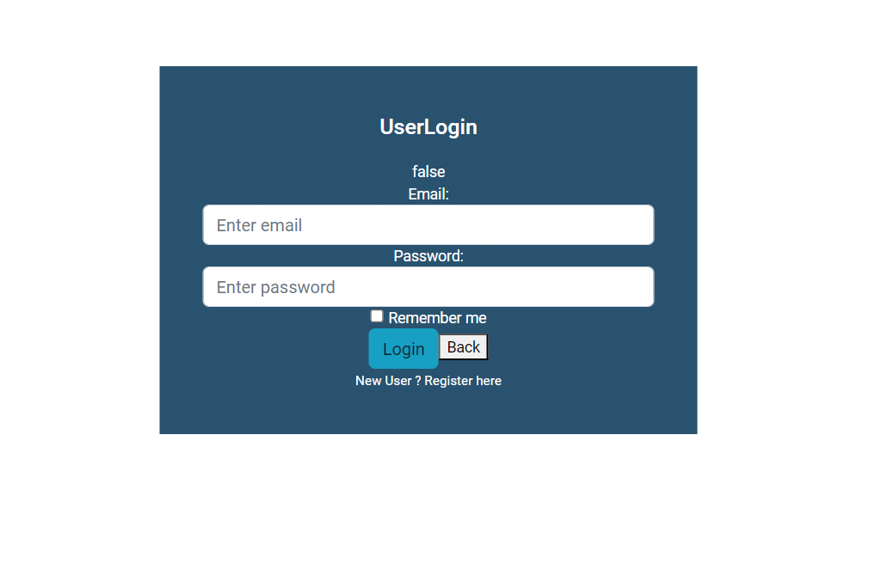
User Login

Slide 12
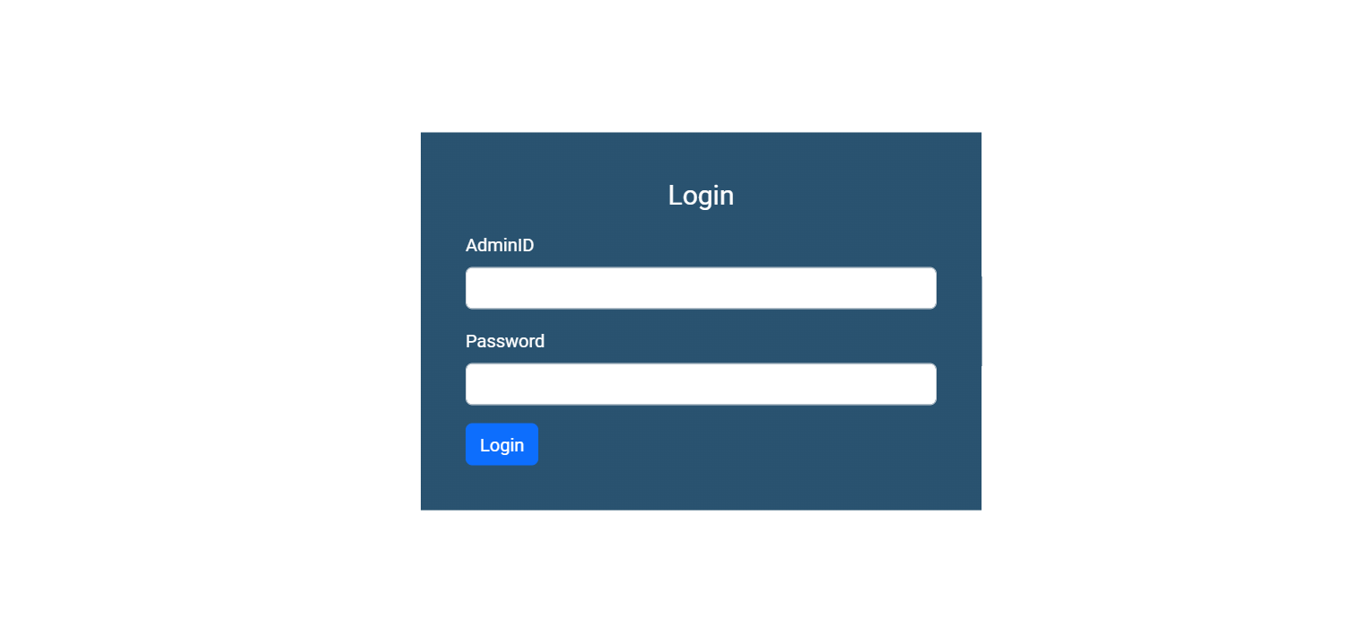
Admin Login

Slide 13
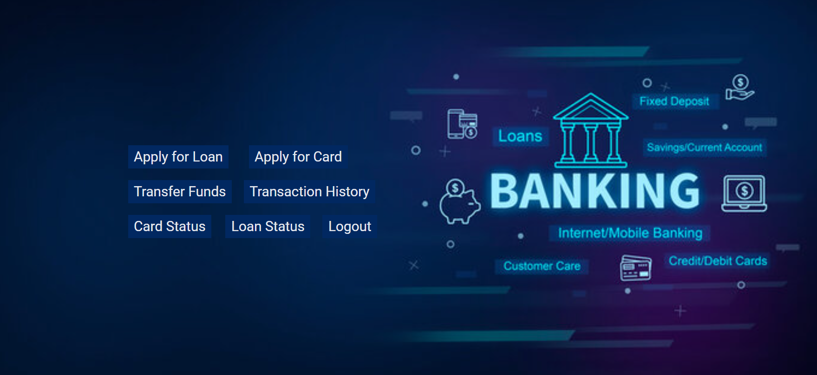
User Operations

Slide 14
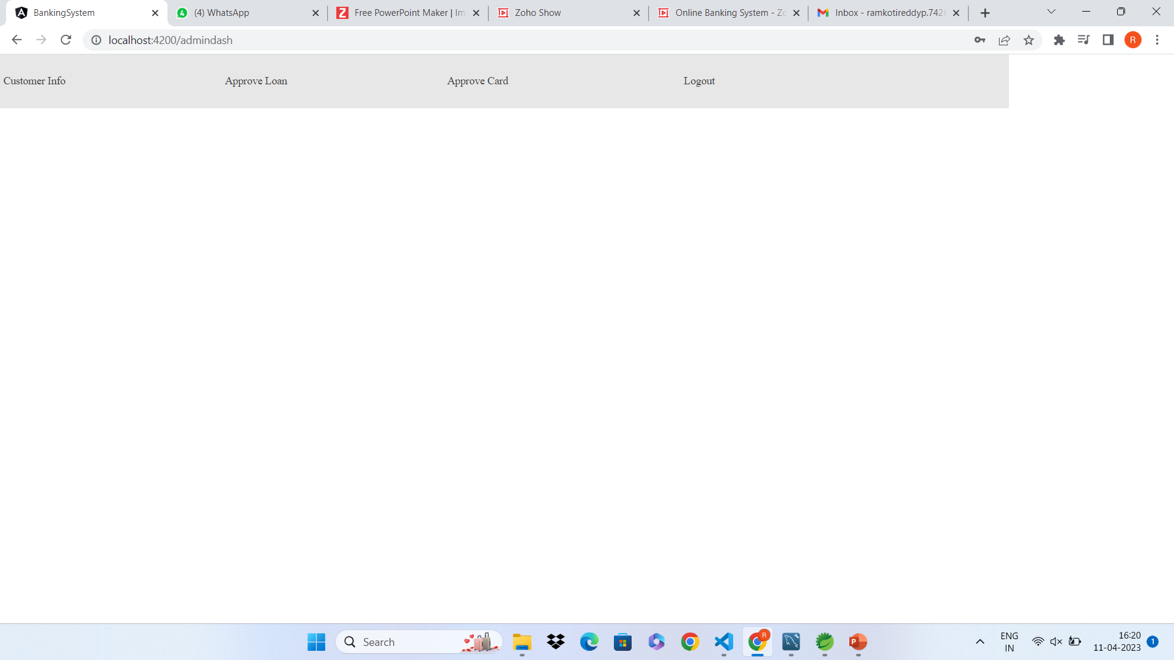
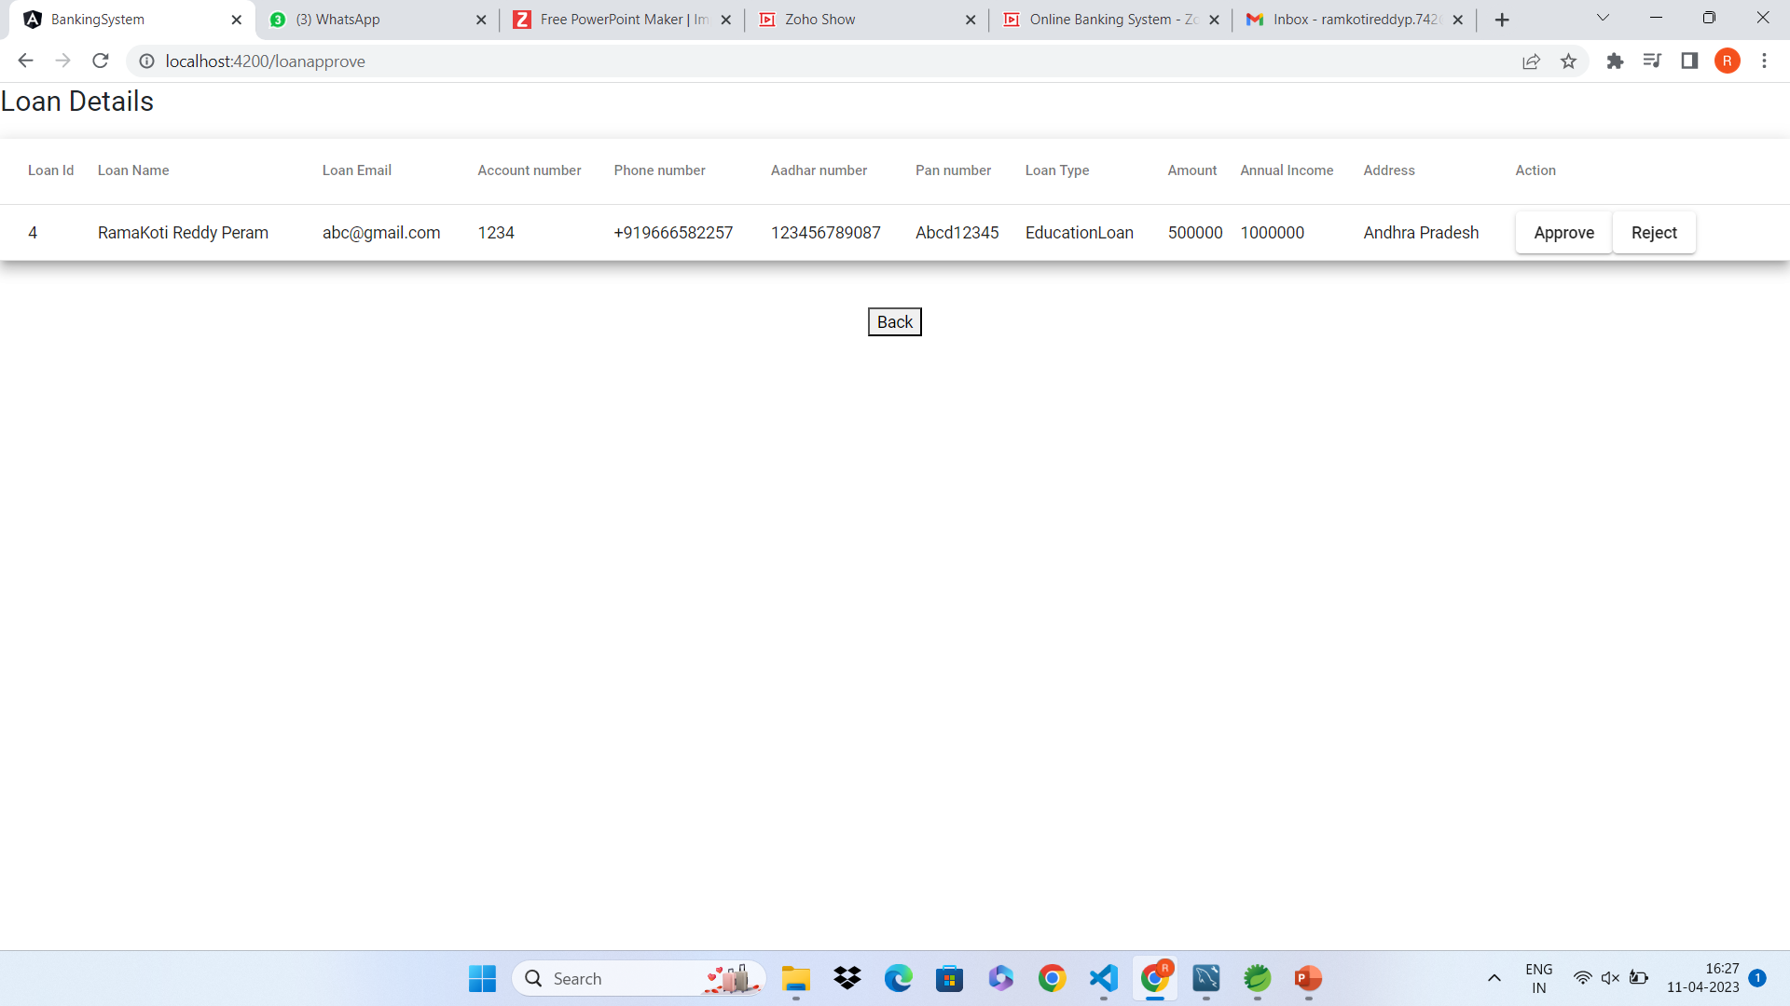
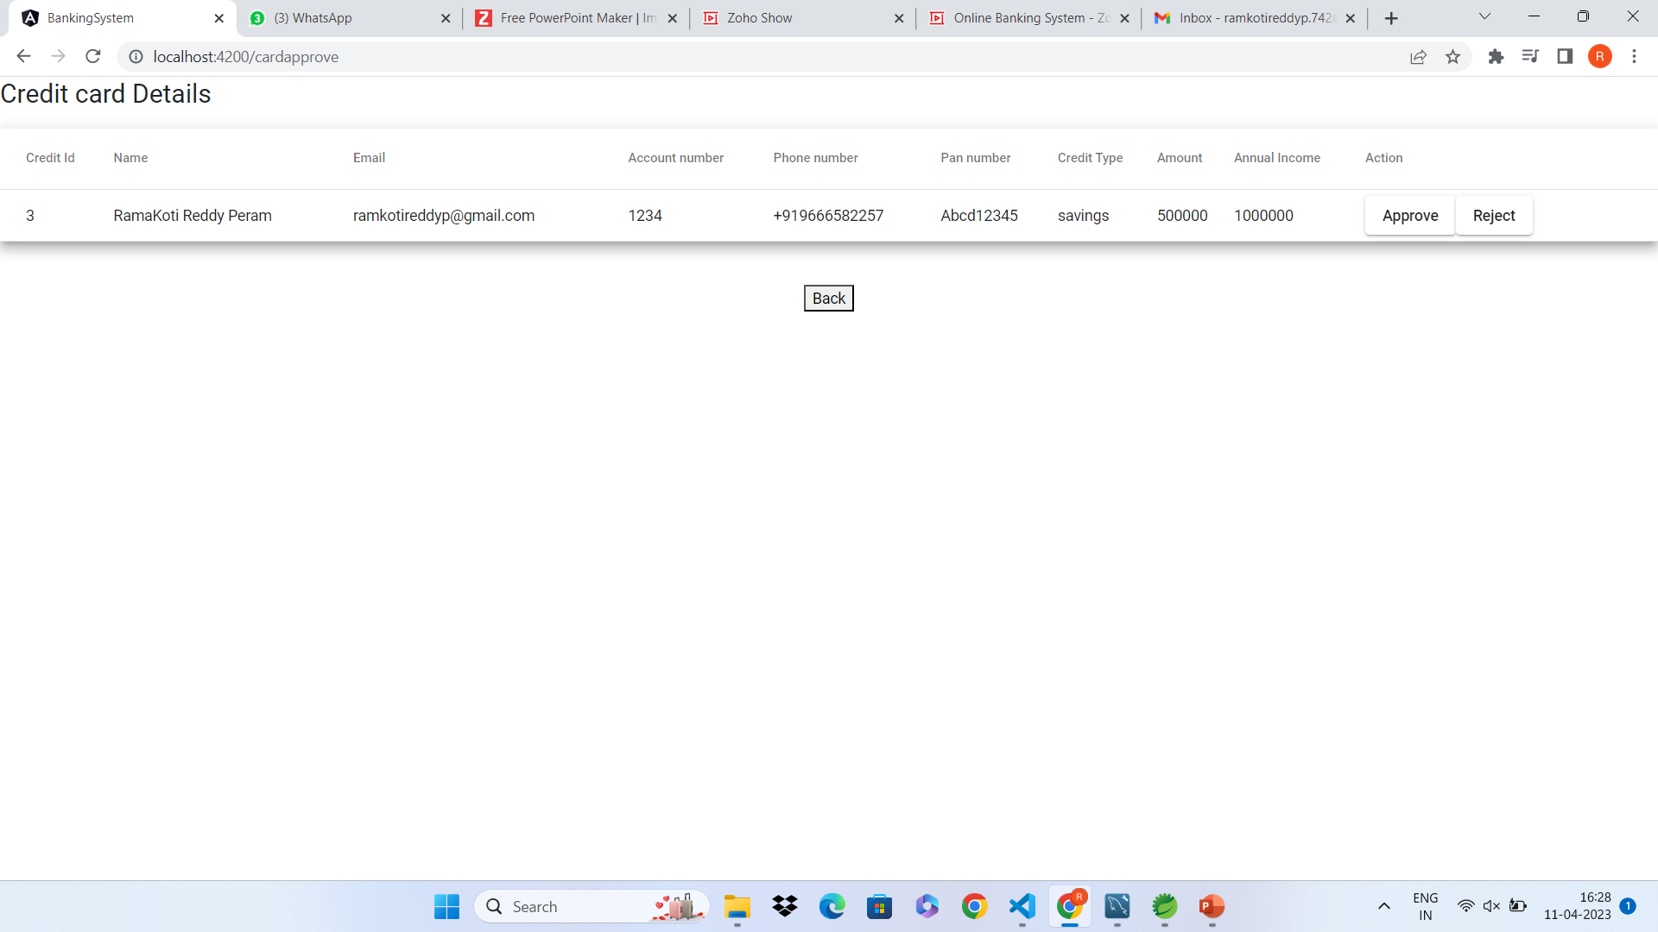
Manager Operations

Slide 15
GitHub Link
https://github.com/koti5a6/Final_Project.git

Slide 16
Thank You

